Slide 1
Introduction to Programming

Slide 2


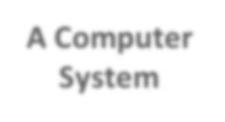
What is a Computer?
A computer is an electronic device capable of performing commands
Commands: The basic commands that a computer performs are input (get data), output (display result), storage, and performance of arithmetic and logical operations
A Computer System
Instructions
Results
Data

Slide 3
Introduction
Without software, the computer is useless
Software developed with programming languages
C++ is a programming language
C++ suited for a wide variety of programming tasks
Before programming, it is useful to understand terminology and computer components
3

Slide 4
The Language of a Computer
When you press A on your keyboard, the computer displays A on the screen.
But what is actually stored inside the computer’s main memory?
What is the language of the computer?
How does it store whatever you type on the keyboard?
4

Slide 5
The Language of a Computer
Electrical signals are used inside the computer to process information. There are two types of electrical signals: analog and digital.
Analog signals: are continuous wave forms used to represent such things as sound. Audio tapes, for example, store data in analog signals.
Digital signals: represent information with a sequence of 0s and 1s.
0 represents a low voltage, and
1 represents a high voltage
5

Slide 6
The Language of a Computer
Digital signals: sequences of 0s and 1s
Machine language: language of a computer
Binary digit (bit):
The digit is called binary digit or bit 0 or 1
Binary code:
A sequence of 0s and 1s
Byte:
A sequence of eight bits is called a byte
6

Slide 7
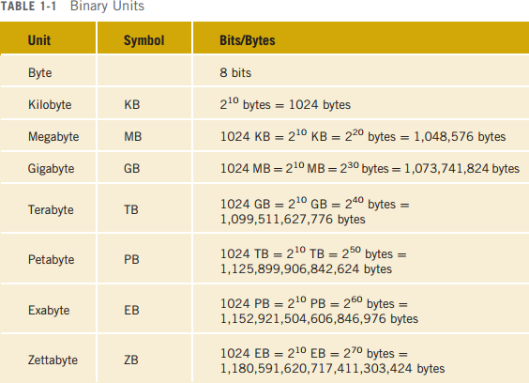
The Language of a Computer (cont'd.)
7

Slide 8
The Language of a Computer (cont'd.)
ASCII (American Standard Code for Information Interchange) The most commonly used encoding scheme on personal computers is the seven-bit American Standard Code for Information Interchange (ASCII)
Consists of 128 characters: 0-127
A is encoded as the binary number 1000001 (66th
character in ASCII)
3 is encoded as 0110011
8

Slide 9
The Language of a Computer (cont d.)
Inside the computer, every character is represented as a sequence of eight-bits, that is, as a byte.
ASCII is a seven-bit code. Therefore, to represent each ASCII character inside the computer, you must convert the seven-bit binary representation of an ASCII character to an eight-bit binary representation
This is accomplished by adding 0 to the left of the seven-
bit ASCII encoding of a character.
Example: Character A is represented as 01000001, and the character 3 is represented as 00110011 by adding 0 to the left.
9

Slide 10
The Evolution of Programming Languages
Early computers were programmed in machine language
To calculate wages = rates * hours in machine language:
100100 | 010001 | //Load
100110 | 010010 | //Multiply
100010 | 010011 | //Store
10

Slide 11
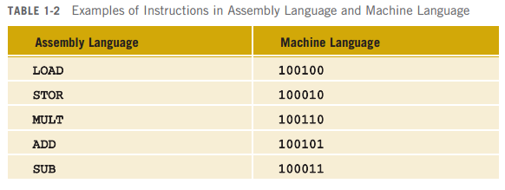
The Evolution of Programming Languages (cont'd.)
Assembly language instructions are mnemonics Assembler: translates a program written in assembly language into machine language
11

Slide 12
The Evolution of Programming Languages (cont'd.)
Using assembly language instructions, wages = rates • hours can be written as:
LOAD MULT STOR
rate hour wages
12

Slide 13
The Evolution of Programming Languages (cont'd.)
The next step toward making programming more easier (high-level languages)
13

Slide 14
Programming Languages
Classification of programming languages:
Machine language (0s and 1s)
Low-level languages (Assembly)
High-level languages (Close to natural languages such as English, French, German, and Spanish. Basic, FORTRAN, COBOL, Pascal, C, C++, C#, Java)

Slide 15
1. Machine level languages
A computer understands only sequence of bits or 1’s and 0’s (the smallest piece of information)
A computer program can be written using machine languages (01001101010010010….)
Very fast execution
Very difficult to write and debug
Machine specific (different codes on different machines)

Slide 16

2. Low level languages
English encrypted words instead of codes (1’s and 0’s)
More understandable (for humans)
Example: Assembly language
Requires: “Translation” from Assembly code to Machine code
Assembly Code Machine Code
compare: cmpl #oxa,n
cgt end_of_loop acddl #0x1,n
end_of_loop:
1001010101001101
1110010110010100
0101010111010010
0110100110111011
1101100101010101
Assembler

Slide 17
3. High level languages
Mostly machine independent
Close to natural language (English like language keywords)
Easy to write and understand programs
Easy to debug and maintain code
Requires compilers to translate to machine code
Slower than low-level languages

Slide 18
3. High level languages examples
Some Popular High-Level languages
COBOL (COmmon Business Oriented Language)
FORTRAN (FORmula TRANslation)
BASIC (Beginner All-purpose Symbolic Instructional Code)
Pascal (named for Blaise Pascal)
Ada (named for Ada Lovelace)
C (whose developer designed B first)
Visual Basic (Basic-like visual language by Microsoft)
C++ (an object-oriented language, based on C)
Java

Slide 19
High-Level Language C++
The instruction written in C++ is much easier to understand and is self-explanatory.
The computer cannot directly execute instructions written in a high-level language. To run on a computer, these C++ instructions first need to be translated into machine language.
A program called a compiler translates instructions written in high level languages into machine code.
Compiler: A program that translates instructions written in a high-level language into the machine language

Slide 20
Processing a C++ Program
#include <iostream> using namespace std; int main()
{
cout << "My first C++ program." << endl; return 0;
}
Sample Run (OUTPUT):
My first C++ program.
20

Slide 21
Terminology
Source Code: A program written in high-level language.
Object program: The machine language version of the high-level language program.
Compiling/Compiler: The action of turning the source code into a format the computer can use (object code).
Linking: Combines object program with other programs (Libraries) provided by the SDK to create executable code
Executable: The result of compiling and linking a source program; the “.exe” file that the computer can run
Loader: A program that loads an executable program into main memory.
The last step is to execute the program

Slide 22
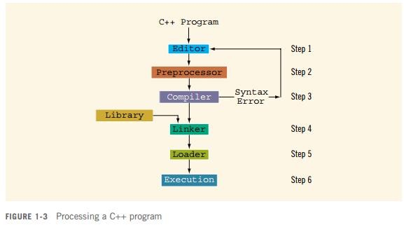
Processing a C++ Program (cont'd.)
22

Slide 23
Another C++ Example
Consider the following C++ program:
#include <iostream> using namespace std; int main()
{
cout<<"My first C++ program."<< endl;
cout<<"The sum | of | 2 | and 3 ="<< | 5 << endl;
cout<<"7 + 8=“ return 0; | << | 7 | + 8 <<endl;
}
OUTPUT: (When you compile and execute this program, the following three lines are displayed on the screen.)
My first C++ program.
The sum of 2 and 3 = 5
7+8= 15

Slide 24
C++ example
#include <iostream> preprocessor directives
main: every c++ program consist of main function
Anything in double quotes is a string. For example, "My first C++ program." and "7+8=" are strings.
7+8 is an arithmetic expression (without quotes)
endl: causes the insertion point to move to the beginning of the next line
cout<<: to print statements to the console.
using namespace std; allows you to use cout and endl
without the prefix std::
The last statement, that is, return 0; returns the value 0 to the operating system when the program terminates.

Slide 25
Problem Solving Steps – Programming Process
Programming is a process of problem solving
Understand the problem
Plan the logic
Code the program
Test the program
Deploy the program into production

Slide 26
1. Understanding the Problem
Problems are often described in natural language like English.
Users may not be able to specify needs well, and the needs may changing frequently
Identify the requirements
Inputs or given data-items
Required output(s) or desired results
Indirect inputs (may not be given directly, you have to calculate or assume)

Slide 27
1. Understanding the Problem
Example: Calculate the area of a circle having the radius of 3 cm
Inputs:
Radius=3
Output:
Area
Indirect Inputs:
Pi=3.14
Area = 3.14 * (3*3) = 28.27

Slide 28
2. Plan the Logic
Identify/Outline small steps in sequence, to achieve the goal (or desired results)
Tools such as flowcharts and pseudocode can be used:
Flowchart: a pictorial representation of the logic steps
Pseudocode: English-like representation of the logic
Walk through the logic before coding

Slide 29
3. Code the Program
Code the program:
Select the programming language
Write the program instructions in the selected programming language
Use the compiler software to translate the program into machine understandable code or executable file
Syntax errors (Error in program instructions) are identified by the compiler during compilation and can be corrected.

Slide 30
4. Test the Program
Testing the program
Execute it with sample data and check the results
Identify logic errors if any (undesired results or output) and correct them
Choose test data carefully to exercise all branches of the logic (Important)

Slide 31
5. Deploy the Program
Putting the program into production
Do this after testing is complete and all known errors have been corrected

Slide 32
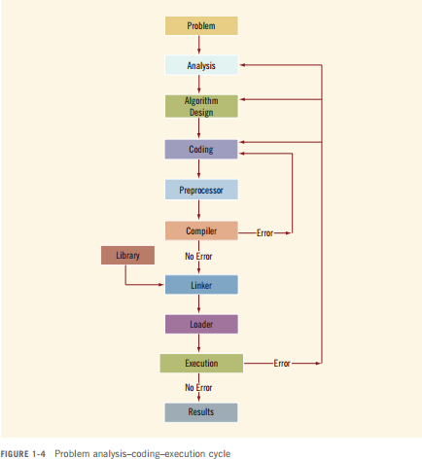

Slide 33
Introduction to Pseudocode
One of the popular representation based on natural language
Widely used
Easy to read and write
Allow the programmer to concentrate on the logic of the problem
Structured in English language (Syntax/grammar)

Slide 34
What is Pseudocode (continued...)
English like statements
Each instruction is written on a separate line
Keywords and indentation are used to signify particular control structures.
Written from top to bottom, with only one entry and one exit
Groups of statements may be formed into modules

Slide 35
What is Pseudocode (continued...)
Example: Calculate the area of a circle having the radius of 3 cm
Pseudocode:
Get radius of a circle
Calculate Area
Display Area

Slide 36
Flowcharts
“A graphic representation of a sequence of operations to represent a computer program”
Flowcharts show the sequence of instructions in a single program or subroutine.

Slide 37
A Flowchart
A Flowchart
Shows logic of an algorithm or problem
Shows individual steps and their interconnections
E.g., control flow from one action to the next

Slide 38
A Flowchart
START
Input Radius (r)
Calculate Area =
3.14 * r * r
Display Area
END

Slide 39
Flowchart Symbols
Name | Symbol | Description
Oval |  | Beginning or End of the Program
Parallelogram |  | Input / Output Operations
Rectangle |  | Processing for example, Addition, Multiplication, Division, etc.
Diamond |  | Denotes a Decision (or branching) for example IF-Then-Else
Arrow |  | Denotes the Direction of logic flow

Slide 40
Relational / Logical Operators
Relational Operators
Operator | Description
> | Greater than
< | Less than
= | Equal to
≥ | Greater than or equal to
≤ | Less than or equal to
≠ | Not equal to

